Slide 1


Web Scraping, EDA &
Data Visualization
of
Prepared by:
Sahil Sawant | Atharva Shirwalkar
Mentored by: Manisha

Slide 2
About us:
Background ?
Atharva Shirwalkar: Bachelor of Engineering (Mechanical)
Sahil Sawant: Bachelor of Engineering (Mechanical)
Why did we want to learn Data Science?
As working professionals in the purchase and quality departments, we both had to deal with large amounts of data on daily basis.
Our profile required us to make data driven decisions for a smooth functionality of supply chain.
This hands-on exposure gradually ignited our interest in understanding how data could be leveraged more efficiently and intelligently.
These experiences helped us to find our passion in this profession.
Any work experience?
Atharva Shirwalkar: 1.5+ Years Experience as Quality Control Engineer
Sahil Sawant: 2+ Years Experience as Design and Purchase Engineer
Share your linkedin and github profile urls:
Atharva’s LinkedIN : https://www.linkedin.com/in/atharva-shirwalkar-5a5071350
Sahil’s LinkedIN : http://www.linkedin.com/in/sahil-sawant-0a13371b1/
Atharva’s GitHub: https://github.com/Atharva9912
Sahil’s GitHub: https://github.com/sawantsahil19

Slide 3
Problem Statement:
Given a dataset of two-wheeler specifications and customer ratings, how can we extract actionable insights about pricing, performance, and brand positioning to help buyers, manufacturers, and sellers make more informed decisions.
Use Case Scenario:
Two-Wheeler Market Analysis for Informed Decision Making
A dealership aggregator wants to help users explore two-wheeler options not just by browsing, but by understanding trends in power, price, and brand performance using data.
Target Users:
Consumers looking to compare bikes by price, power, and brand.
Dealerships optimizing their inventory and pricing strategy.
Manufacturers analyzing their brand’s position in the market relative to competitors.

Slide 4
Objective:
The objective of this project is to perform exploratory data analysis and statistical visualization on a dataset of two-wheelers to uncover patterns and trends related to brand performance, pricing, engine power, and customer satisfaction. By conducting univariate and bivariate analysis, the goal is to enable data-driven insights that support better decision-making for consumers, manufacturers, and retailers in the motorcycle market.
Steps involved while performing Exploratory Data Analysis:
Step 1: Data Scraping
Step 2: Data Cleaning
Step 3: Data Manipulation
Step 4: Univariate Analysis
Step 5: Bivariate Analysis

Slide 5
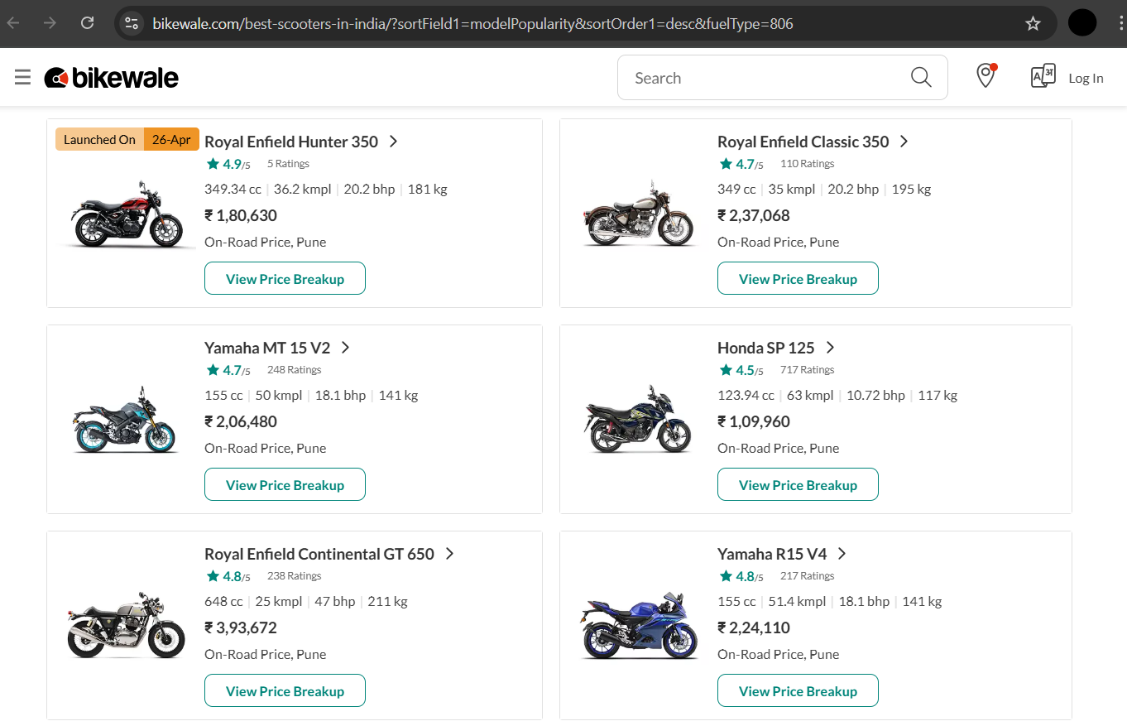
Web Scraping Process:
Website:
https://www.bikewale.com/best-scooters-in-india/?sortField1=modelPopularity&sortOrder1=desc&fuelType=806

Slide 6
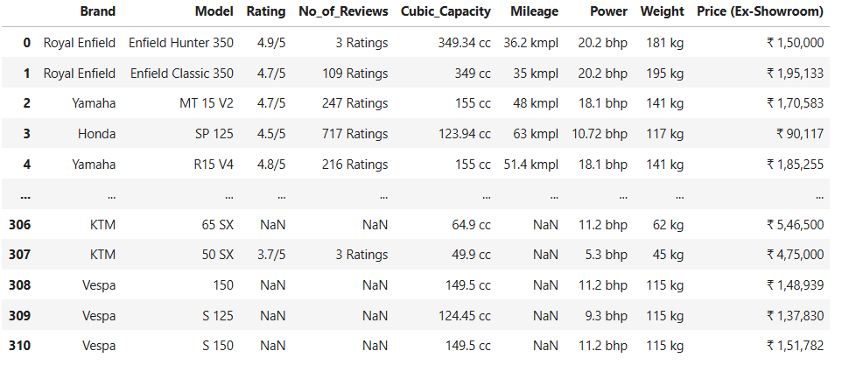
Summary of Data:

Slide 7
Steps performed in Exploratory Data Analysis:
1) Renaming Column Headers:
Feature headers before renaming:
Feature headers after renaming:

Slide 8
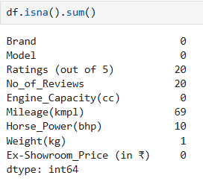
2) Handling of NaN Values:
In our dataset, these features had missing values.
Using IQR method, we checked for outliers in each of the features.
Accordingly, we filled the NaN values using statistical methods in Measures of Central Tendency such as mean, median and mode.
Outliers in our dataset were less than 5% and were valid and relevant to our analysis, so handling these outliers would have affected our final outcome.

Slide 9
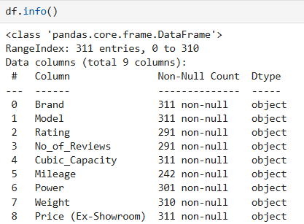
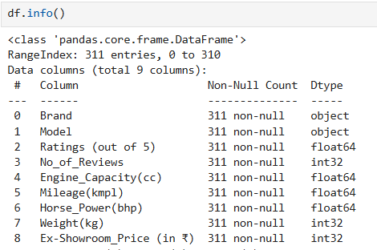
3) Converting DataTypes:
Before Conversion:
After Conversion:

Slide 10
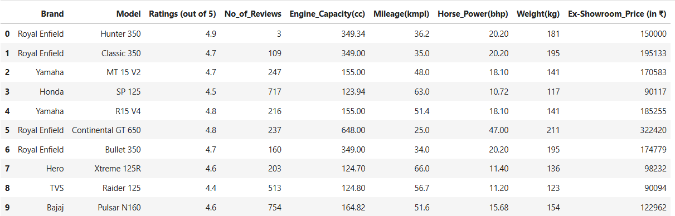
3) Final Dataset:
After data cleaning and manipulation, this is how our dataset looked like.

Slide 11
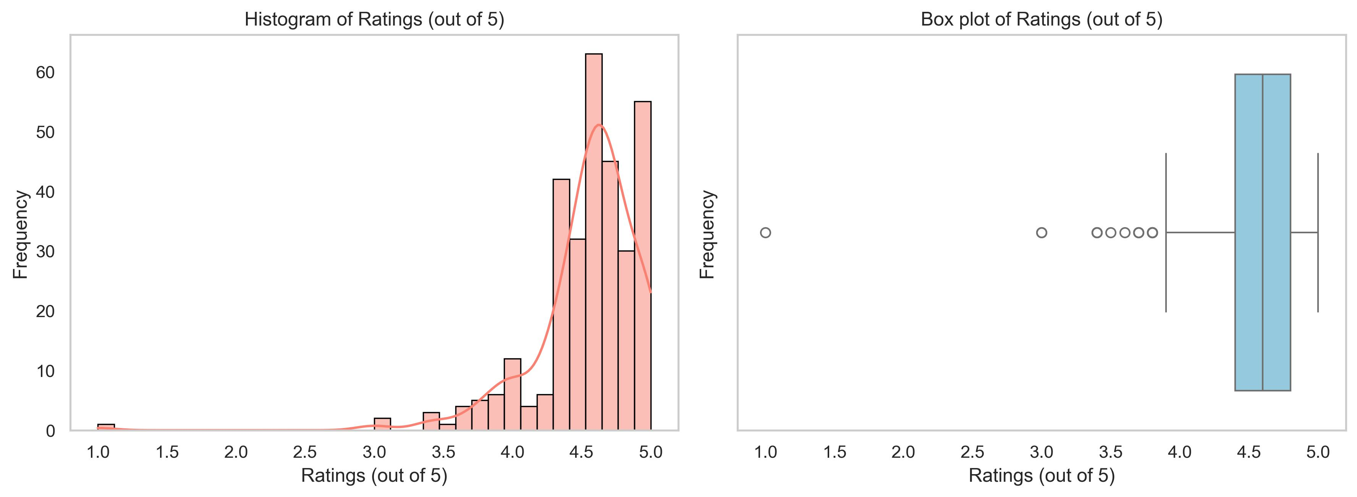
Data Visualization: Univariate Analysis
Univariate Analysis on ‘Ratings’ feature:
Observation:
As per the above plots, we can see that the data is left skewed.
This indicates that most ratings lie between 4 to 5 showcasing general customer satisfaction.
Some outliers can be observed in the plots. The lack of low ratings may indicate limited negative reviews.

Slide 12
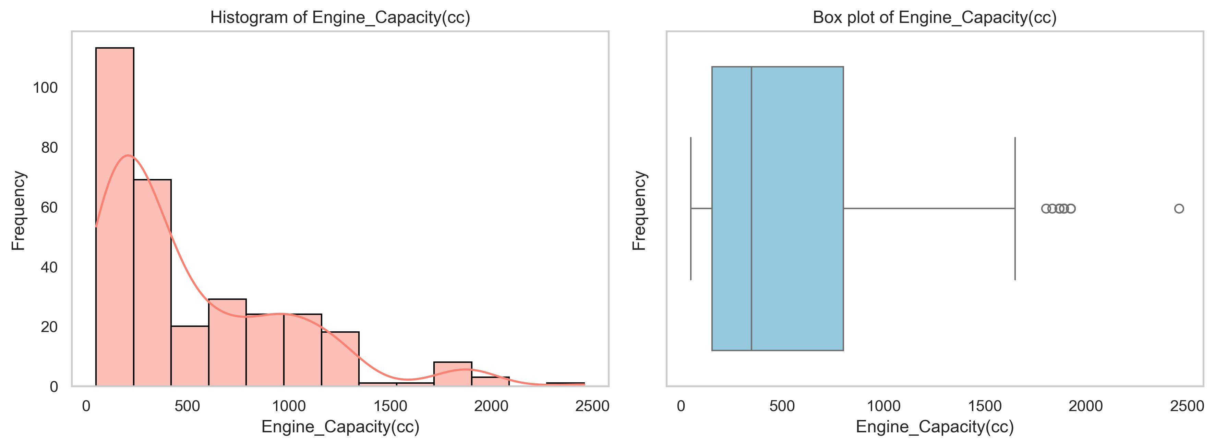
Univariate Analysis on ‘Engine Capacity’ feature:
Observation:
From above plots we can deduce that most bikes have Engine Capacity between 100-400cc. These are usually commuter bikes mostly preferred for city riding.
Fewer bikes lie between 500-1200cc. (Mostly super sport, hyper sport and adventure tourer bikes)
Also, some outliers can be observed, indicating lower frequency of 1500-2000cc bikes.(Mostly high-end cruiser bikes)

Slide 13
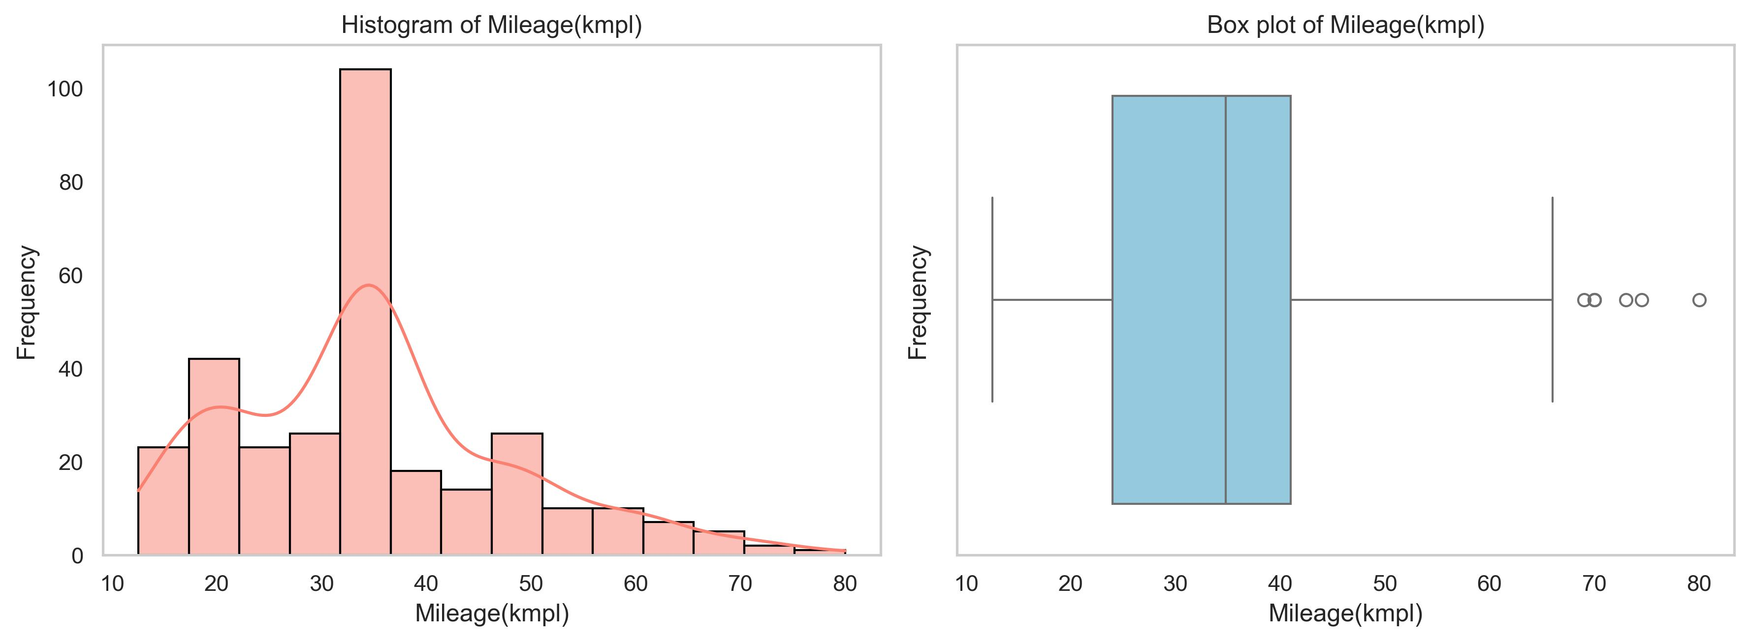
Univariate Analysis on ‘Mileage’ feature:
Observation:
Above plots indicate that most bikes in the Indian market offer a mileage of 30-40kmpl.
We can also observe that a decent no. of bikes have an average of 15-30kmpl
Few outliers on the right side indicate that, there are bikes offering mileage between 60-80kmpl. (Mostly commuter bikes)

Slide 14
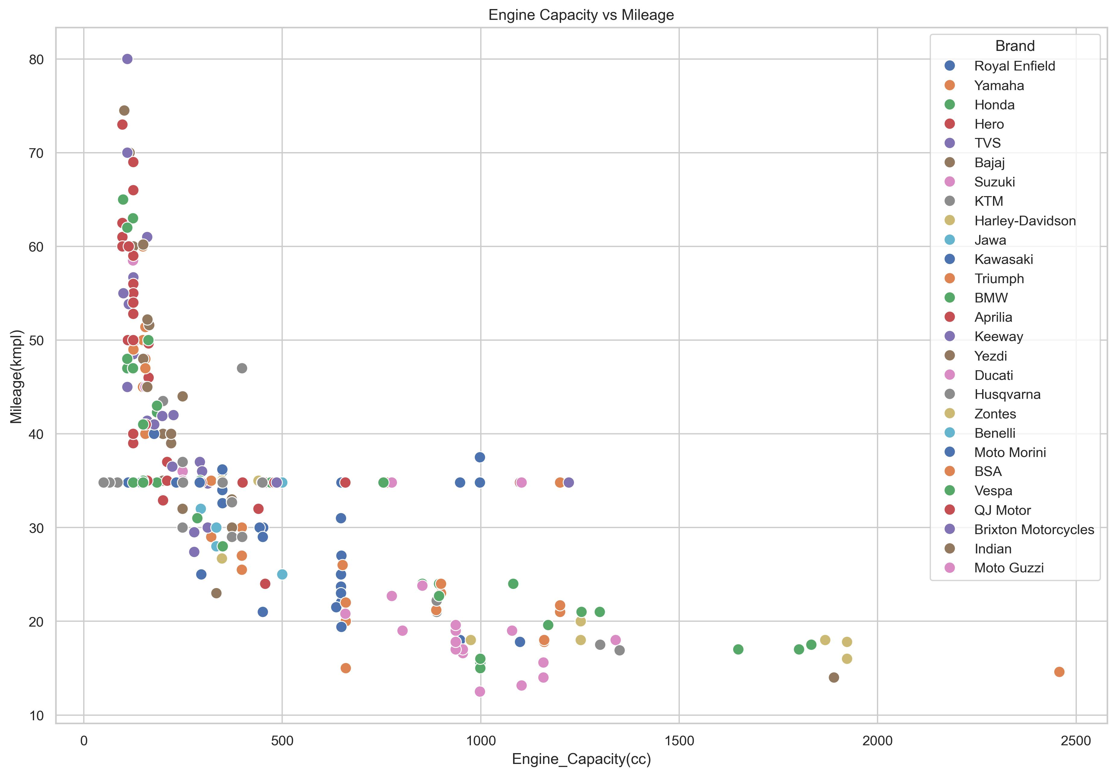
Data Visualization: Bivariate Analysis
Bivariate Analysis on Engine Capacity vs Mileage: (Numerical vs Numerical Datatype)
Observation:
From above plot we can see negative correlation.
This indicates that higher the 'Engine capacity' of the bike, lower the mileage it offers and vice versa.
Generally it means that 'Mileage' is inversely proportional to the cubic capacity(cc) of the engine.

Slide 15
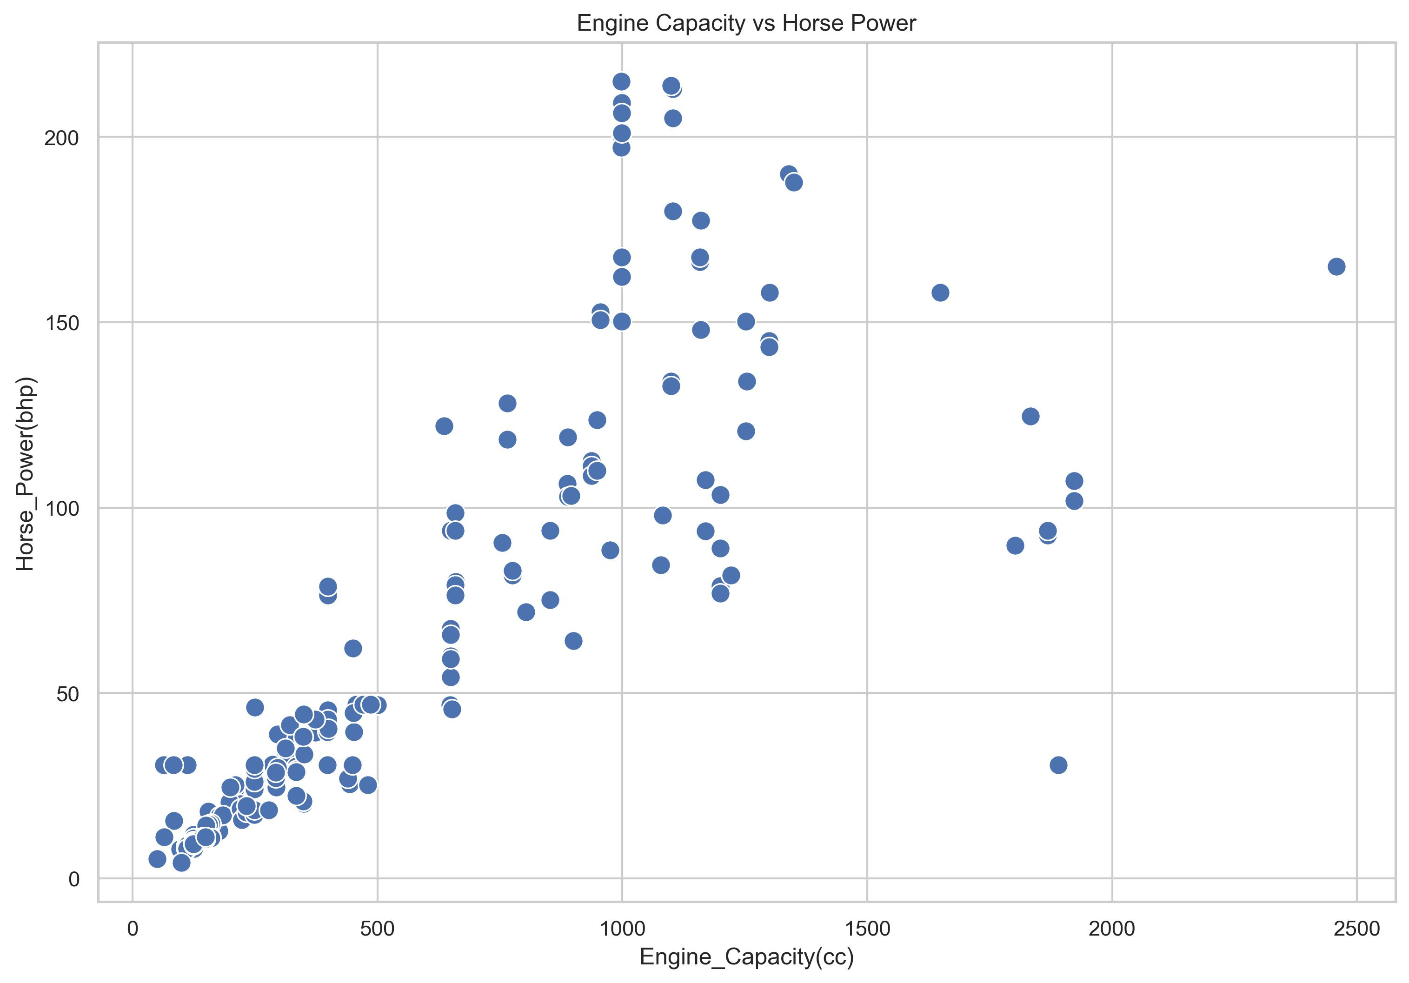
Bivariate Analysis on Engine Capacity vs Horse Power: (Numerical vs Numerical Datatype)
Observation:
Above plot typically shows engine performance relationship, meaning higher the 'Engine Capacity', higher the 'Horse Power'.
We can also see an observation which shows a dip in 'Power' despite its 'Engine capacity' being higher than 1500cc; this is because those bikes fall under the 'Cruiser' segment which generally have higher 'cc' but lower 'bhp'.

Slide 16
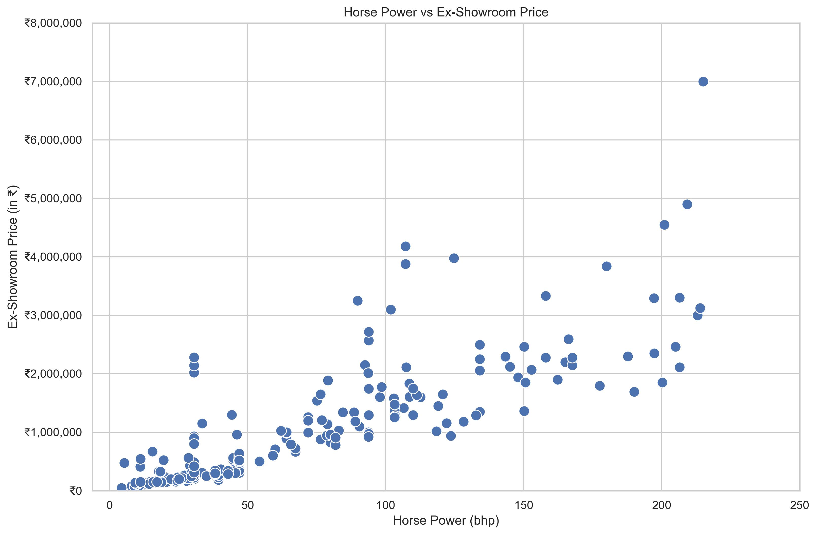
Bivariate Analysis on Horse Power vs Ex-Showroom Price: (Numerical vs Numerical Datatype)
Observation:
This plot clearly shows that powerful bikes have higher cost.
Also, most of the clutter is in the price range of ₹0 to 10,00,000 which shows that you get up to 50bhp under the price range of ₹10Lakhs
As the bhp traverses from 50 to 200, the price gradually increases.

Slide 17
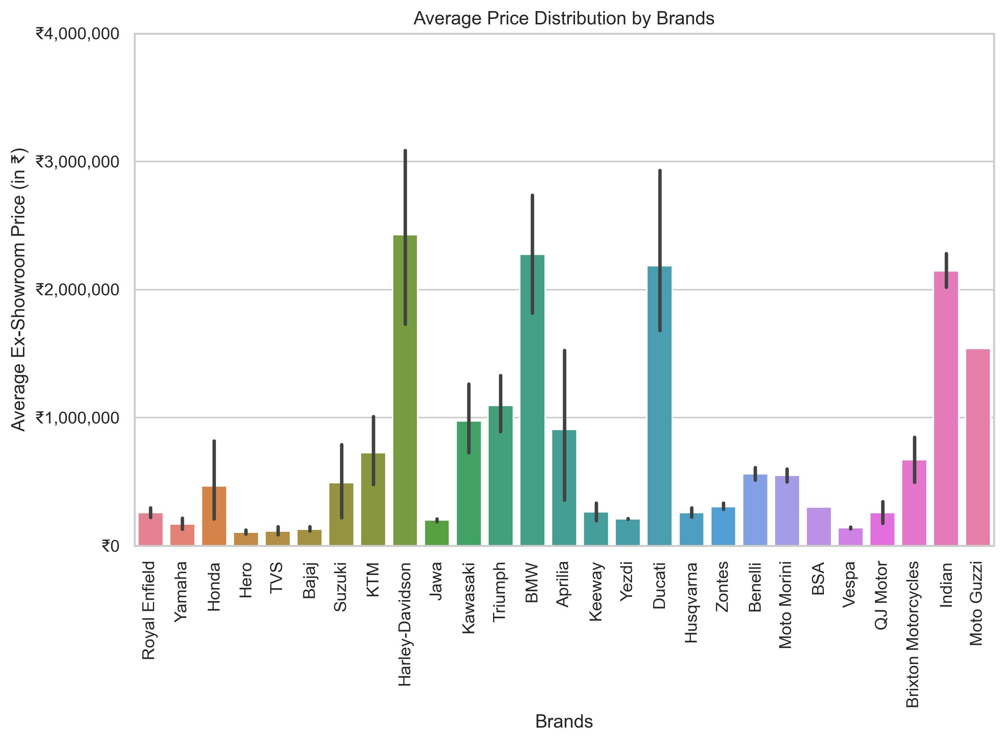
Bivariate Analysis on Brand vs Ex-Showroom Price: (Categorical vs Numerical Datatype)
Observation:
Above plot shows average Ex-Showroom Prices of each Brand.
Brands like 'Harley-Davidson’, 'BMW’, 'Ducati' and 'Indian' come under the premium segment of bikes having average prices above ₹20,00,000.
'Triumph' and 'Moto Guzzi' fall under the sub-premium segment of bikes averaging prices between ₹10,00,000 to ₹20,00,000.
Rest of the bike brands come under the budget category.

Slide 18
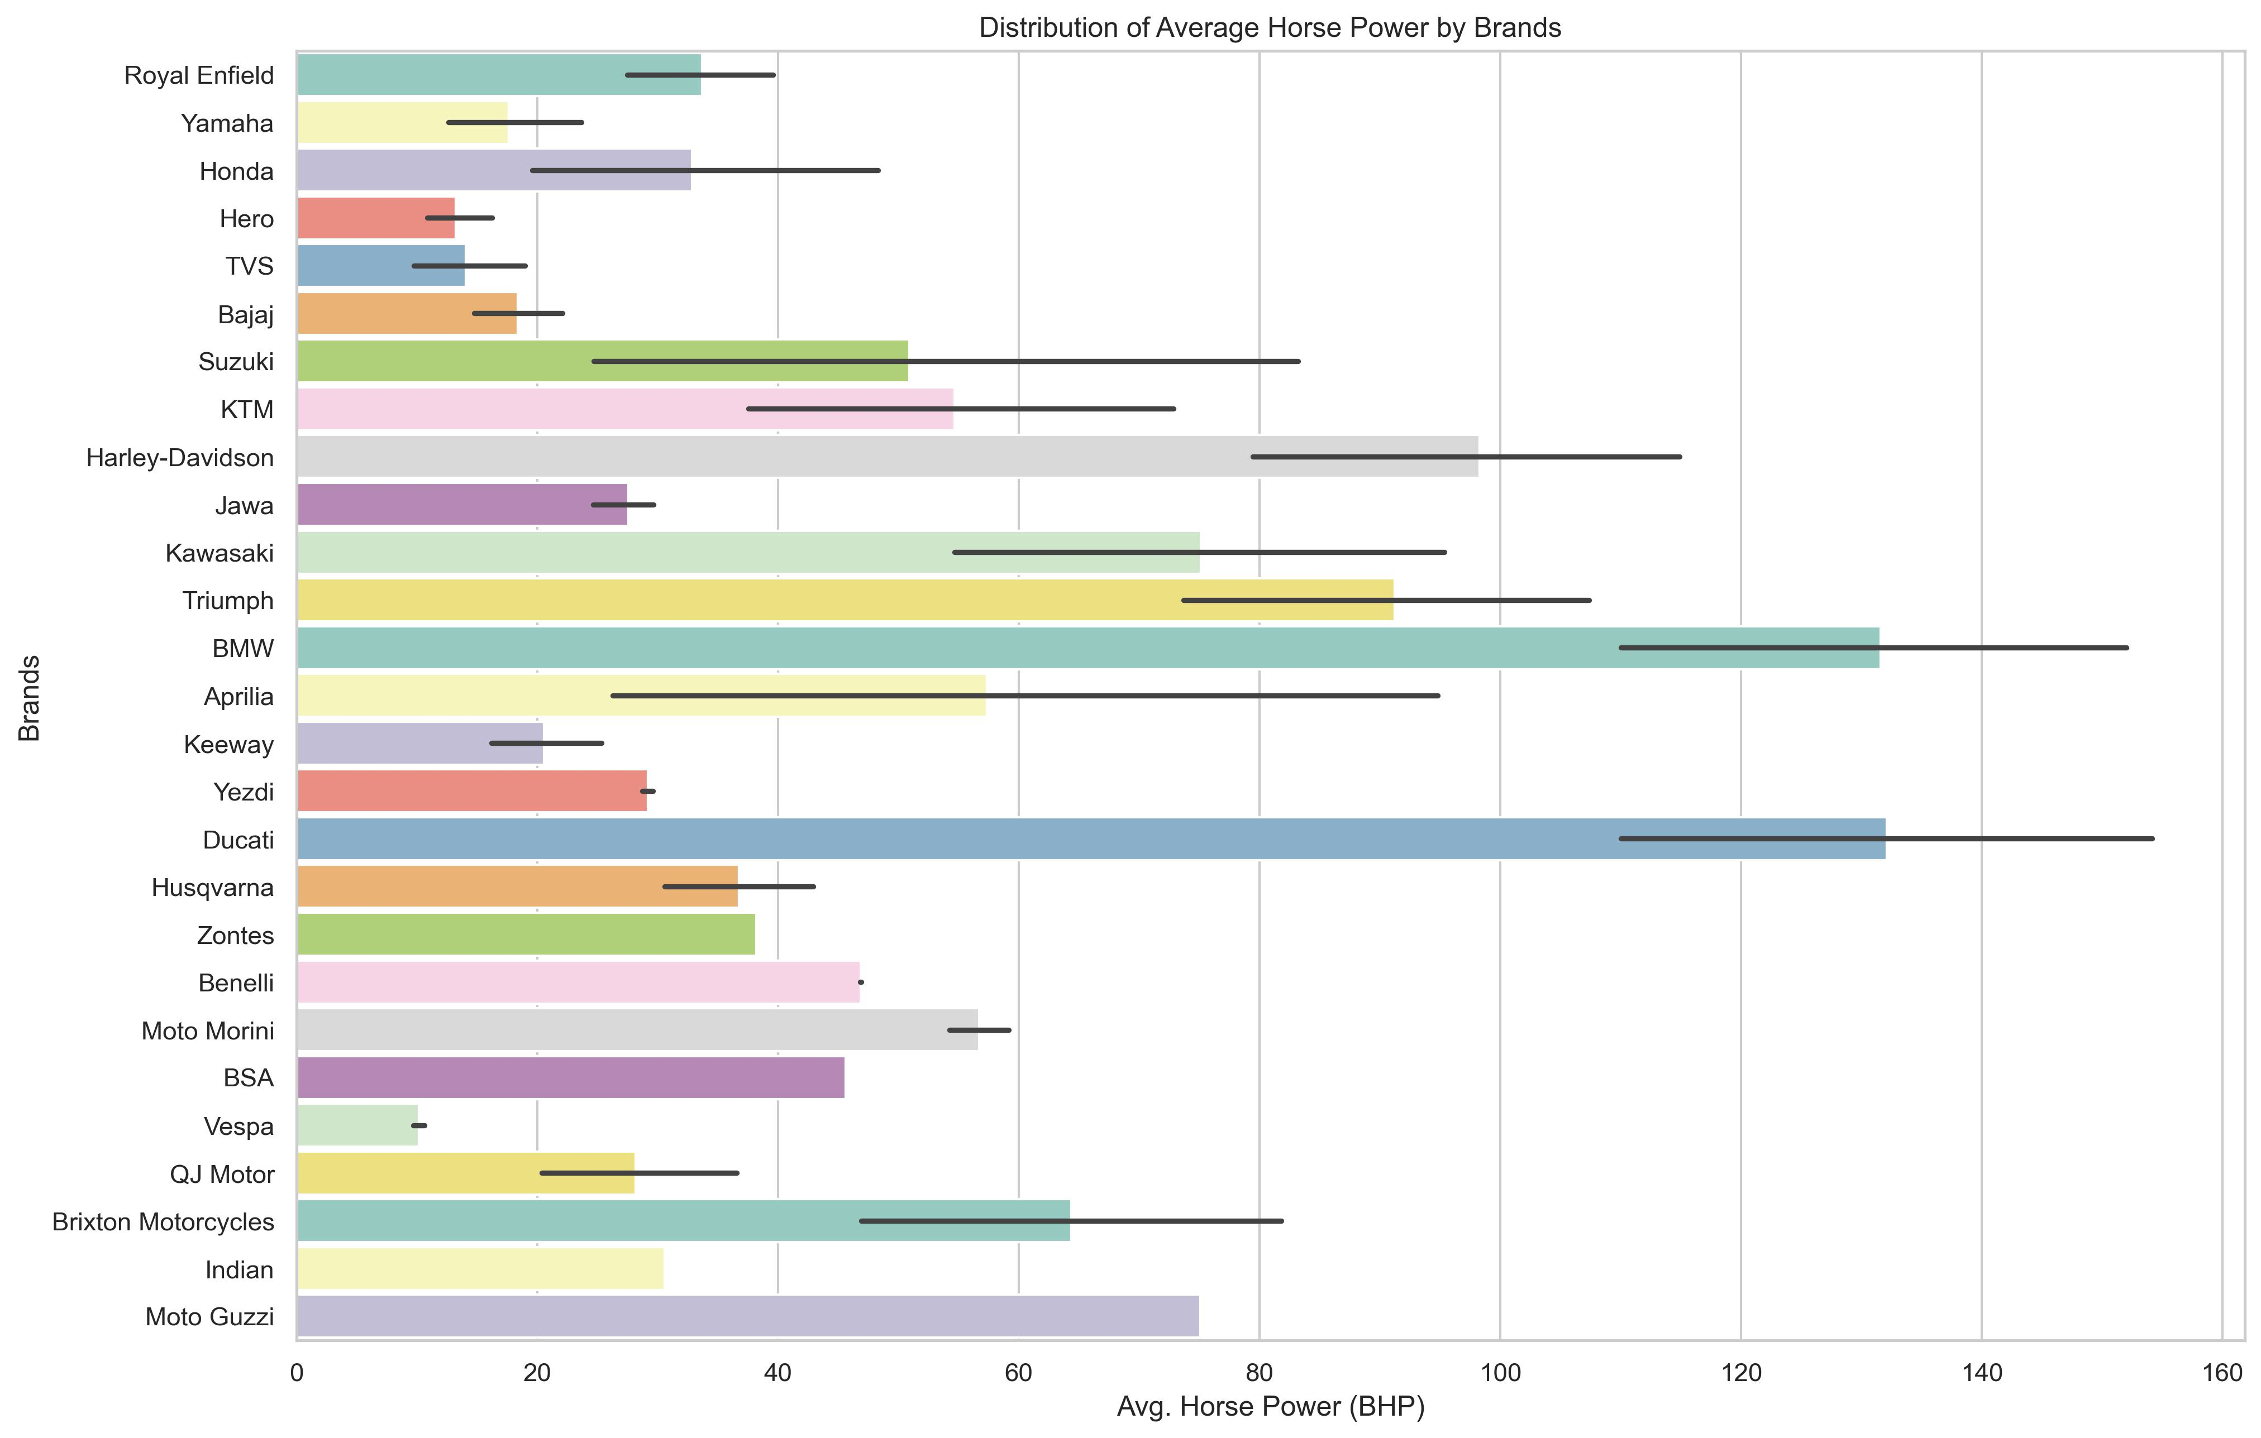
Bivariate Analysis on Brand vs Horse Power: (Categorical vs Numerical Datatype)
Observation:
Brands like 'BMW' and 'Ducati' lead the chart with bikes having average BHP above 120.
'Yamaha', 'Royal Enfield', and 'Honda' fall into a moderate power segment, suggesting a balance between affordability and performance.
Brands like Vespa, Hero, Keeway, and TVS have lower average horsepower, indicating a focus on commuter or entry-level motorcycles, having smaller engine displacements and urban use cases.

Slide 19
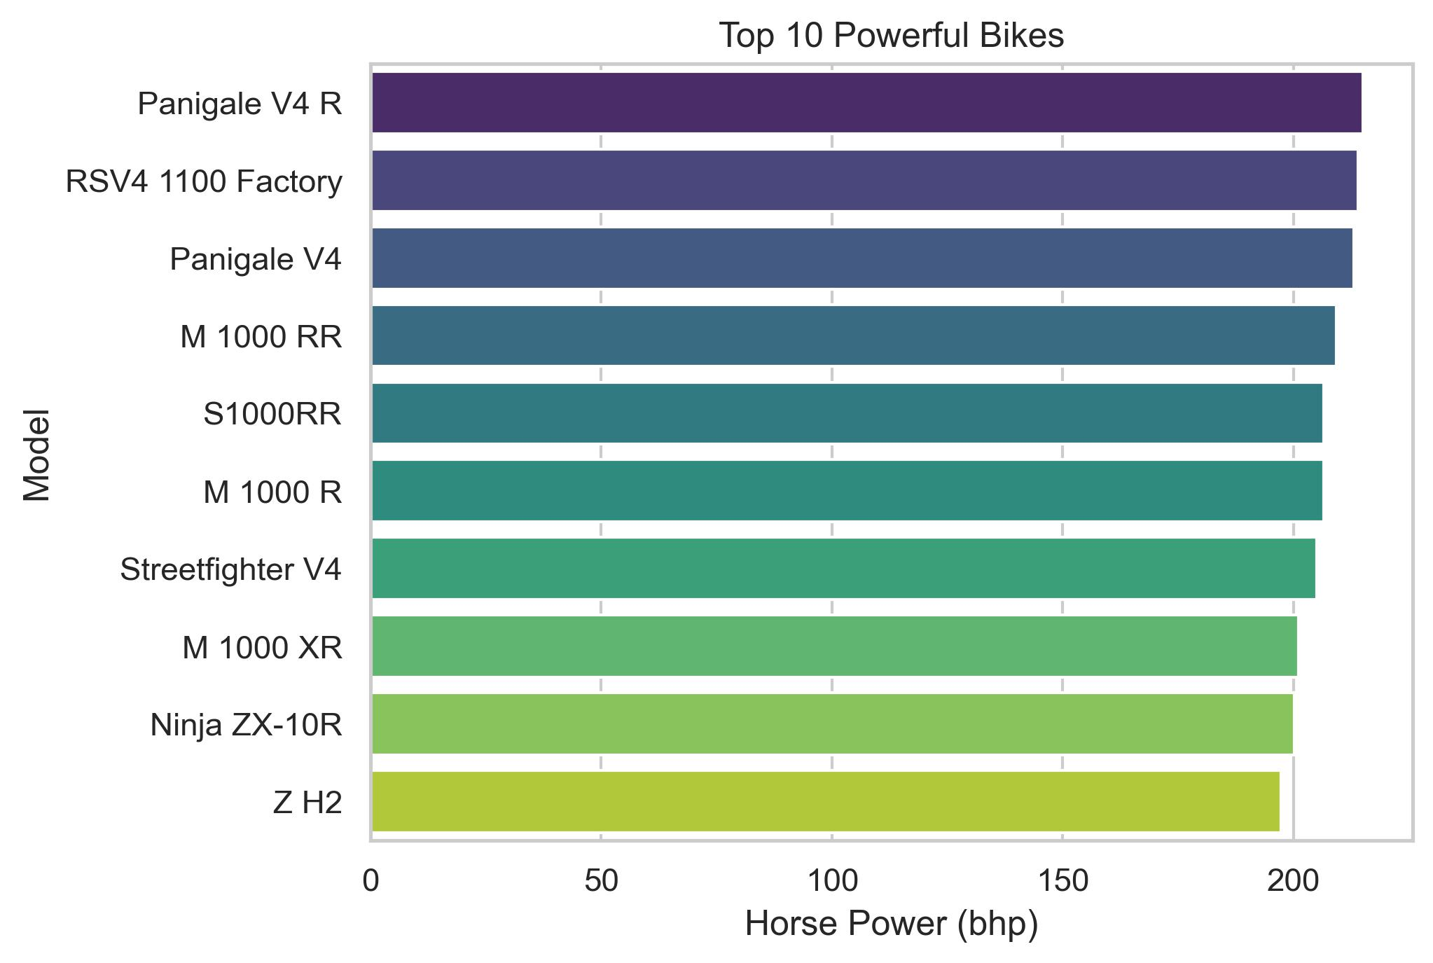
Bivariate Analysis on Model vs Horse Power: (Categorical vs Numerical Datatype)
Observation:
Above plot showcases top 10 motorcycle models based on their performance.

Slide 20
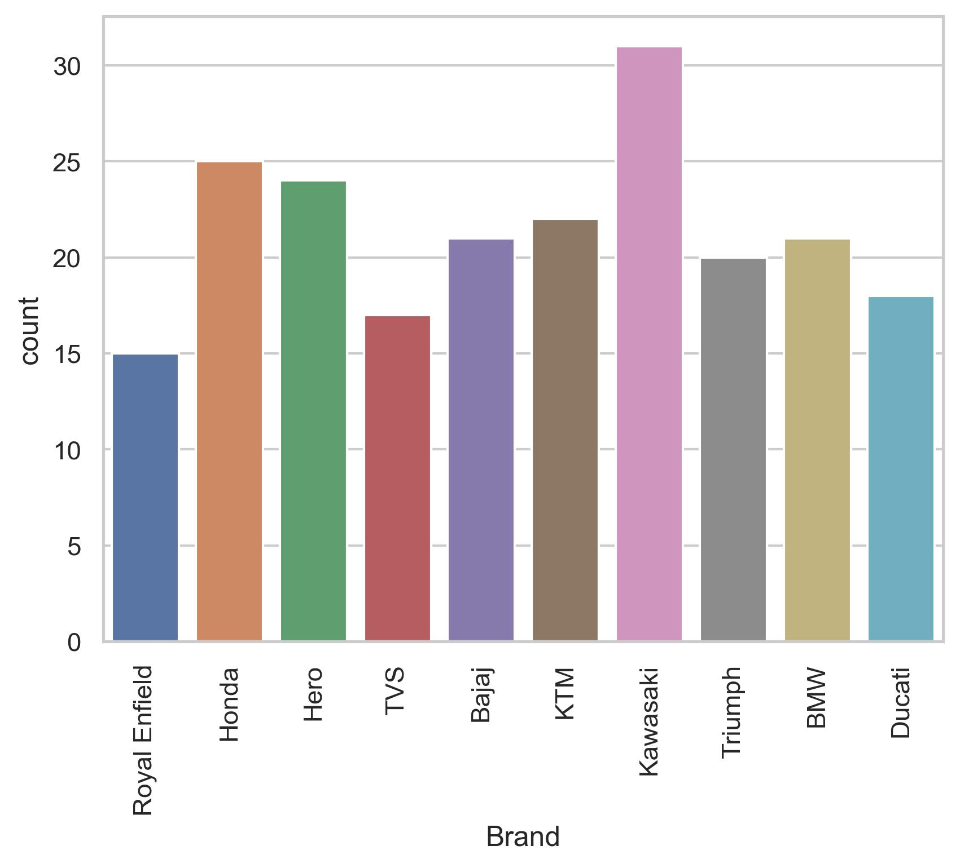
Count plot of Top 10 brands with most number of bikes in the market:
Observation:
This plot showcases top 10 brands with most number of bikes in Indian market.

Slide 21
Conclusion:
The bike market in the dataset is commuter-focused, but there’s a visible premium segment led by niche brands like Ducati, BMW, and Kawasaki which stand out in performance.
BHP and engine size correlate with price but inversely with mileage.
There is a clear positive correlation between horsepower and ex-showroom price, confirming that higher-performance bikes tend to cost significantly more.
Most bikes received high ratings, indicating general customer satisfaction, though some lower-rated outliers suggest specific areas for improvement.
Budget-friendly brands (like Hero and TVS) offer lower horsepower at more affordable prices.
Box plots revealed price and rating outliers, helping identify potential flagship models or underperforming bikes.
Ratings can be a powerful qualitative indicator, especially for mid-range buyers.

Slide 22

THANK YOU

